Slide 1
Angular - Routes
Susithra Chandrabose

Slide 2
Training Outline
Location strategies
Configuring routes
Passing data to routes
Child routes
Gaurding routes

Slide 3
Single Page applications (SPA)
SPA doesn't refresh the entire page to display different views
1
SPA is a collection of view states. Home, Product Details, Shipping etc
2
A component router allows the user to navigate from one view to another within the SPA
3
Notes:
Tip: Add your own speaker notes here.

Slide 4
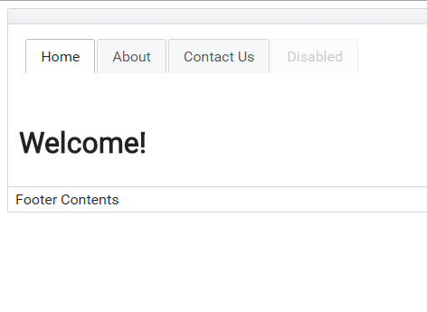
SPA
Different views will be displayed here.
<router-outlet></router-outlet>
These contents will not change
Notes:
Tip: Add your own speaker notes here.

Slide 5
Location Strategies
HashLocationStrategy
the hash sign is added to the URL. The fragment after # identifies the route on the client
PathLocationStrategy
a History API based strategy works only in the browsers that support HTML5

Slide 6
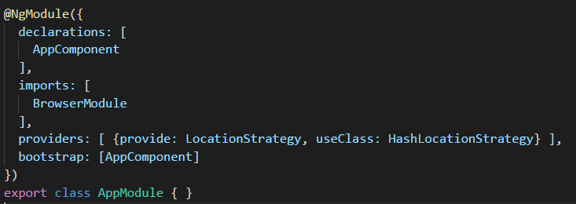
Location Strategies
HashLocationStrategy
http://mysite.com:8080/#/products/page/3
– Location on the server
– route path
– route parameter

Slide 7
Lesson 2: Objectives
List the intended outcomes for this training session.
Each objective should be concise, contain a verb, and have measurable results.
Notes:
Tip: Add your own speaker notes here.

Slide 8
Lesson 2: Content
Add text here.
To add a picture, chart, or other content in the right column, click the appropriate icon.
To add a slide, click the Slides tab, then click the New Slide gallery.

Slide 9
Lesson 2: Wrap-up
Summarize important points.
Allow time for questions.

Slide 10
Lesson 3: Objectives
List the intended outcomes for this training session.
Each objective should be concise, contain a verb, and have measurable results.
Notes:
Tip: Add your own speaker notes here.

Slide 11
Lesson 3: Content
Add text here.
To add a picture, chart, or other content in the right column, click the appropriate icon.
To add a slide, click the Slides tab, then click the New Slide gallery.

Slide 12
Lesson 3: Wrap-up
Summarize important points.
Allow time for questions.

Slide 13
Summary of Training
List important points from each lesson.
Provide resources for more information about the subject.
List resources on this slide.
Provide handouts with additional resource material.

Slide 14
Assessment and Evaluation
Prepare a quiz or challenge to assess how much information participants learned.
Survey participants to see if they found the training beneficial.

